Slide 1
CSA5801 - DEVSECOPS ENGINEERING AND APPLICATION SECURITY
MS1 Jul-Sep 2026 - SLOT A
SECURE STUDENT INFORMATION MANAGEMENT SYSTEM WITH ROLE-BASED ACCESS CONTROL
Guided by, Dr. R. Pitchandi
Associate Professor
Department of Applied Machine Learning
SIMATS Engineering
Presented by,
192465006–V GIRI PRASATH
192421004 – A AUSTIN
192521170 – V LOKEH KUMAR
192565015 – B THARUNKUMAR REDDY

Slide 2
Abstract
The Secure Student Information Management System with Role-Based Access Control (RBAC) is a web-based application designed to securely manage student records. while preventing unauthorized access to sensitive information. The system assigns specific roles such as Administrator, Faculty, and Student, with each role having predefined permissions to access only the data required for its responsibilities. It incorporates secure user authentication, password encryption, and session management to protect user accounts and maintain data confidentiality. The application enables efficient management of student details, academic records, attendance, and results through a centralized database. By implementing RBAC, the system enhances security, ensures data integrity, and simplifies user management. This solution provides an efficient, reliable, and secure platform for educational institutions to manage student information while reducing the risks of data breaches and unauthorized modifications.

Slide 3
Introduction
Student information in educational institutions contains sensitive data that must be stored and managed securely.
Traditional manual or unsecured systems are vulnerable to unauthorized access, data loss, and record manipulation.
A Secure Student Information Management System provides a centralized platform to manage student records efficiently.
Role-Based Access Control (RBAC) ensures that users such as administrators, faculty, and students can access only authorized information.
The system uses secure authentication, password encryption, and session management to protect user accounts and data.

Slide 4
Literature Survey
Author(s), Year, Journal/Proceedings | Title | Key Findings
Sandhu, R., Coyne, E. J., Feinstein, H. L., & Youman, C. E., 1996, IEEE Computer | Role-Based Access Control Models | Introduced the RBAC model, defining roles, permissions, and role hierarchies for secure access control in information systems.
Ferraiolo, D. F., Sandhu, R., Gavrila, S., Kuhn, D. R., & Chandramouli, R., 2001, ACM Transactions on Information and System Security (TISSEC) | Proposed NIST Standard for Role-Based Access Control | Established the NIST RBAC standard, improving authorization, user management, and security through standardized role-based permissions.
Joshi, J. B. D., Bertino, E., Latif, U., & Ghafoor, A., 2005, IEEE Transactions on Knowledge and Data Engineering | A Generalized Temporal Role-Based Access Control Model | Extended RBAC by incorporating time-based constraints, enabling secure and flexible access control for enterprise applications.
Kuhn, D. R., Coyne, E. J., & Weil, T. R., 2010, IEEE Computer | Adding Attributes to Role-Based Access Control | Discussed integrating attribute-based policies with RBAC to provide more dynamic and fine-grained access control.
Hu, V. C., Ferraiolo, D. F., Kuhn, D. R., et al., 2013, NIST Special Publication 800-162 | Guide to Attribute Based Access Control (ABAC) Definition and Considerations | Compared RBAC and ABAC, highlighting the advantages of secure authorization and policy-based access management.
Mouakket, S., 2021, International Journal of Information Management | Information Security and Access Control in Higher Education Systems | Demonstrated that implementing secure authentication and role-based authorization significantly improves the protection of student information systems.

Slide 5
Research Gaps
Existing RBAC models mainly focus on access control principles but provide limited implementation for complete student information management systems.
Many studies emphasize authorization techniques without integrating features such as attendance, marks, and student profile management.
Traditional RBAC systems lack modern security mechanisms like secure password encryption, session management, and audit logging.
Previous research focuses on enterprise environments, with limited attention to the specific requirements of educational institutions. .

Slide 6
Problem Statement
Existing student information management systems often lack fine-grained role-based access control, leading to unauthorized access and potential data breaches.
There is a need for a secure system that enforces role-specific permissions to protect sensitive student information while ensuring efficient and controlled access for administrators, faculty, and students.

Slide 7
Objectives
To develop a secure student information management system with Role-Based Access Control (RBAC) that authenticates users and restricts access based on their assigned roles.
To enable administrators, faculty, and students to securely manage and access academic records through authentication, authorization, and a centralized database while ensuring data confidentiality and integrity.

Slide 8
Module 1: User Authentication & Role Management
User registration and secure login.
Password encryption and validation.
User profile management.
Role assignment for Admin, Faculty, and Student.
Secure logout and session management.
Password reset and account recovery.

Slide 9
Module 2: Student Information Management
Add and update student details.
Manage academic and course information.
Maintain attendance records.
Store student information securely.
Manage student records and documents.
Generate student information reports.

Slide 10
Module 3: Role-Based Access Control (RBAC)
Define user roles and permissions.
Restrict access based on assigned roles.
Allow Admin to manage system resources.
Allow Faculty to access authorized student data.
Allow Students to view permitted information.
Prevent unauthorized access to restricted data.

Slide 11
Module 4: Audit Logs & Security Monitoring
Record user login and logout activities.
Track data access and modifications.
Monitor unauthorized access attempts.
Maintain detailed audit logs.
Monitor suspicious user activities.
Generate security and activity reports.

Slide 12
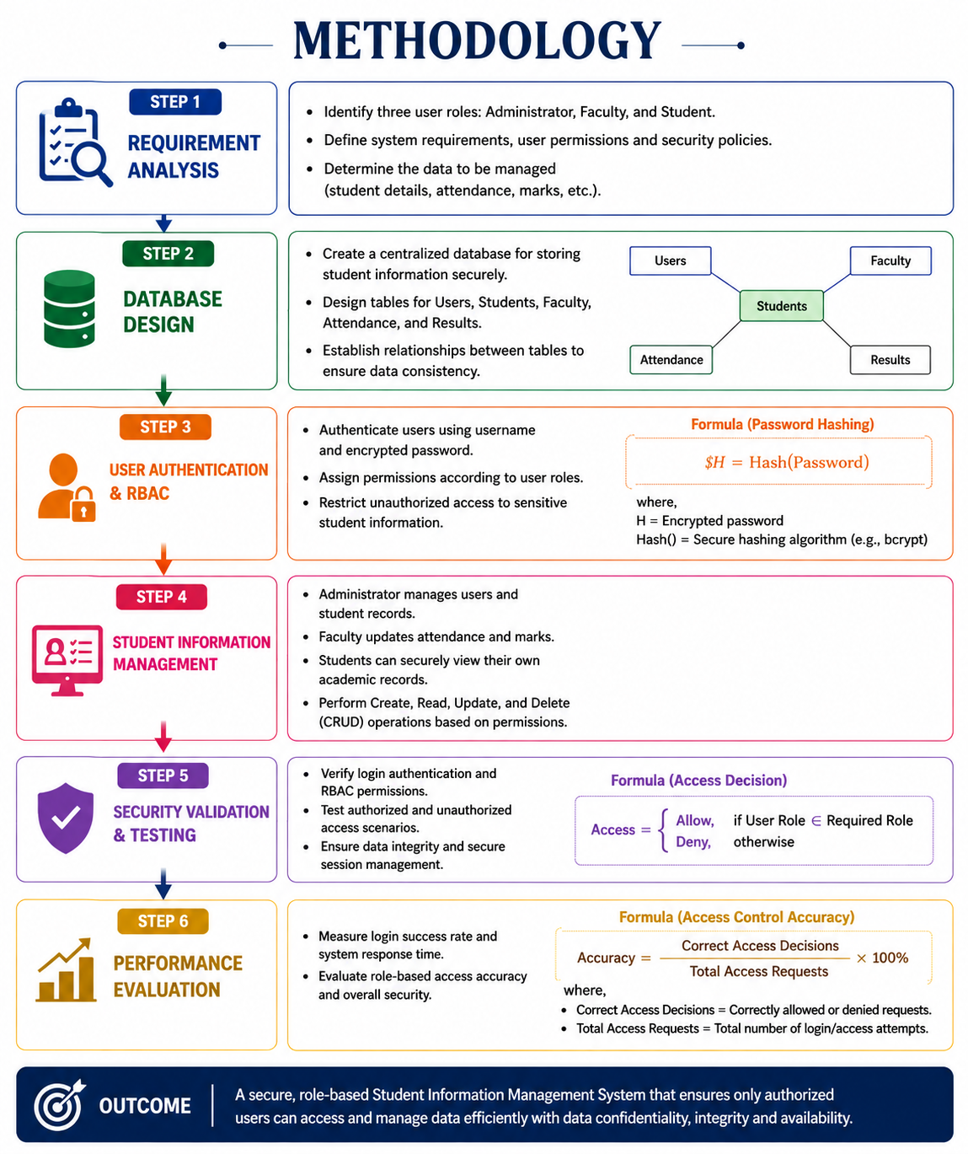
Methodology

Slide 13
Discussion
Simulates interactions between students, faculty, and administrators.
Generates data on login attempts and role-based access requests.
Measures system performance under different user loads.
Evaluates the effectiveness of Role-Based Access Control (RBAC).
Helps improve data security and overall system reliability.

Slide 14
Results
Role-Based Access Control (RBAC) successfully restricted unauthorized access.
Authentication accuracy improved with secure login validation.
Unauthorized access attempts were detected and blocked.
Evolution plots show minimal fluctuations for all variables, confirming dataset reliability for deeper analysis.
Overall system security, reliability, and efficiency were improved

Slide 15
Conclusion
The proposed Secure Student Information Management System effectively protects sensitive student data.
Role-Based Access Control (RBAC) ensures users access only authorized information.
The Hybrid ABM-SD model helps evaluate system security and performance.
Unauthorized access is minimized through secure authentication and access control.
The proposed solution is scalable and suitable for educational institutions.

Slide 16
Future Scope
Integrate multi-factor authentication (MFA) for stronger security.
Use AI/ML to detect suspicious user behavior and insider threats.
Support cloud-based deployment for better scalability and accessibility.
Implement blockchain for secure and tamper-proof academic records.
Develop a mobile application for secure access to student information.

Slide 17
References
Computer Security: Principles and Practice, 5th ed., Pearson, 2023.
Security Engineering: A Guide to Building Dependable Distributed Systems, 3rd ed., Wiley, 2020.
Database System Concepts, 7th ed., McGraw-Hill, 2019.
National Institute of Standards and Technology, Digital Identity Guidelines (SP 800-63), 2023.
OWASP Foundation, OWASP Top 10: Web Application Security Risks, 2021.
Sandhu, R., Coyne, E. J., Feinstein, H. L., & Youman, C. E. (1996). Role-Based Access Control Models. IEEE Computer.
Ferraiolo, D. F., Sandhu, R., Gavrila, S., Kuhn, D. R., & Chandramouli, R. (2001). Proposed NIST Standard for Role-Based Access Control. ACM TISSEC.

Slide 18
The End

